Slide 1
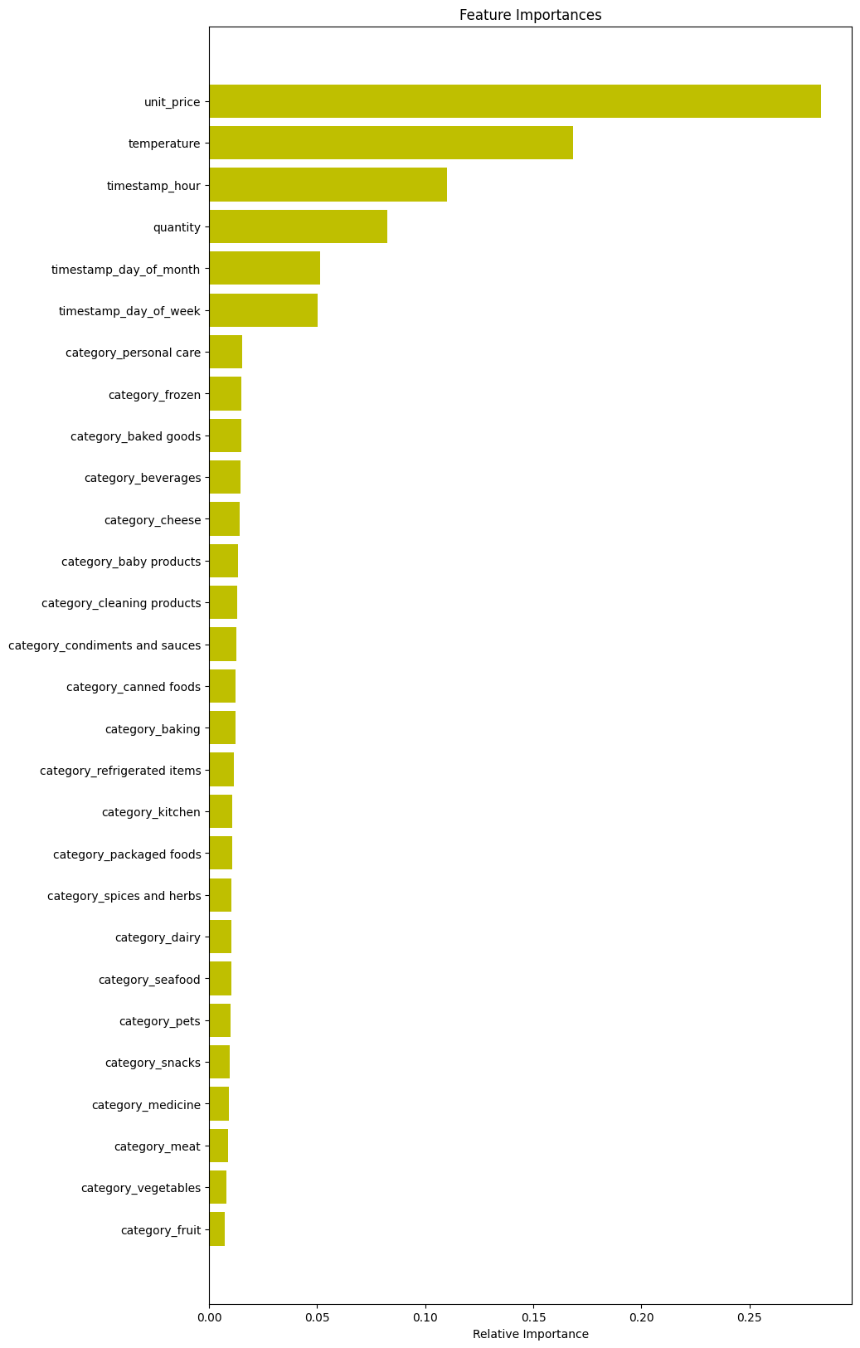
This feature importance visualisation tells us:
-- The product categories were not that important
-- The unit price and temperature were important in predicting stock
-- The hour of day was also important for predicting stock

